Slide 1
LOAN PREDICTION
- Patil Vikrant

Slide 2
Background and Motivation
As the needs of people are increasing, the demand for loans in banks is also frequently getting higher every day. Banks typically process an applicant's loan after screening and verifying the applicant's eligibility, which is a difficult and time-consuming process. In some cases, some applicants default and banks lose capital.
The machine learning approach is ideal for reducing human effort and effective decision making in the loan approval process by implementing machine learning tools that use classification algorithms to predict eligible loan applicants.

Slide 3
Problem Statement
The main objective of this project is to predict whether assigning the loan to particular person will be safe or not. Means pick out which customer will be able to pay the debt and which customer is likely will not be able to pay the debts.
Build a model with respect to all the Independent And Dependent features, Whichever Model perform well pick that model as our final model.

Slide 4
Dataset
Our Data is having 614 row’s and 13 variables.
Categorical Variable’s are 8 and continuous variables are 4.
Continuous Variable’s | Categorical Variable’s
Income | Gender
Coapplicant_Income | Marital Status
Loan Amount | No. Dependents
Tenure | Education Status
 | Self Employed
 | Credit History
 | Property Area

Slide 5
challenges
Lots of null values are present in our data. So we replace the null values by using mean for continuous variables & mode for categorical variables.
Balance & Total Income variables in our data are having outliers. we fixed them by using Quantile method.
we created some derived variables. So we deleted some of the variables like ‘Income’ To avoid multicollinearity.

Slide 6
Tools and Packages
Python Jupyter Notebook
NumPy
Pandas
Matplotlib
Scikit-Learn
Tableau for visualization

Slide 7
DATA Preprocessing :
First for all in our data having ‘Loan ID’ column so we have to replace that column into indexing. Because that variable is not having any predictive power.
Our data is having null values , so for replacing that null values I used ‘Mean’ for numerical variable And ‘Mode’ for categorical variable by Using fillna method.
Balance variable & Total Income in our data are having outliers .we fixed them by using Quantile method.
After that we created a derived variables like :
‘Total Income = Income + Co Applicant Income’
‘EMI = (loan Amount*Interest*(1+Interest)**Tenure)/(1+Interest)**Tenure-1)’
‘Balance = Total Income – EMI’
Then to avoid the multicollinearity we deleted ‘Income’ variable.

Slide 8
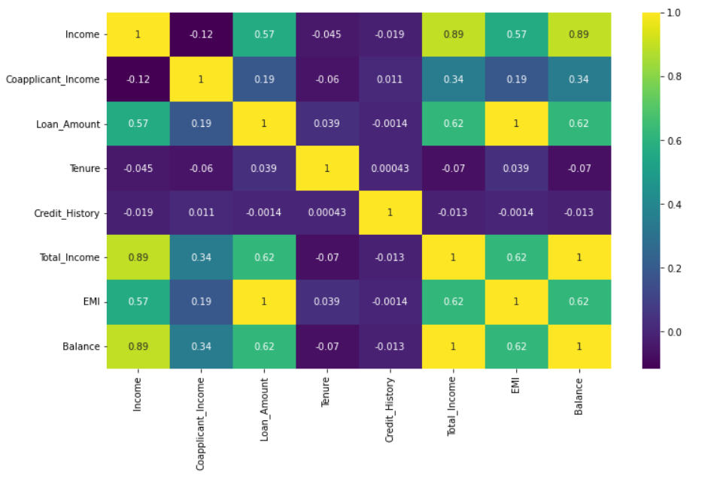
CORRELOGRAM :
Correlogram gives the information about co-relation between the independent Variables.
‘Income’ Variable 89% co-related with ‘Balance’ Variable.
By using correlogram we can see that Income variables are having multicollinearity, so we have to delete one of the variable which is having multicollinearity.
Total Income – Income (89%)
Loan Amount – Balance (62%)

Slide 9
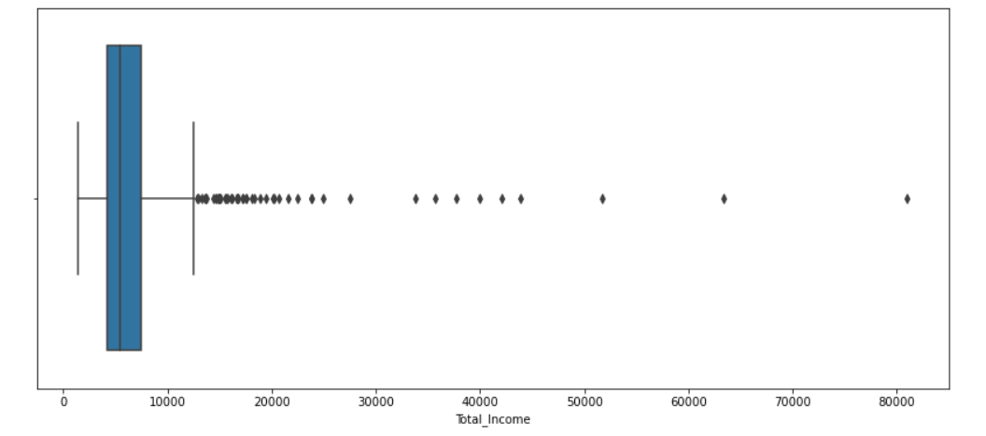
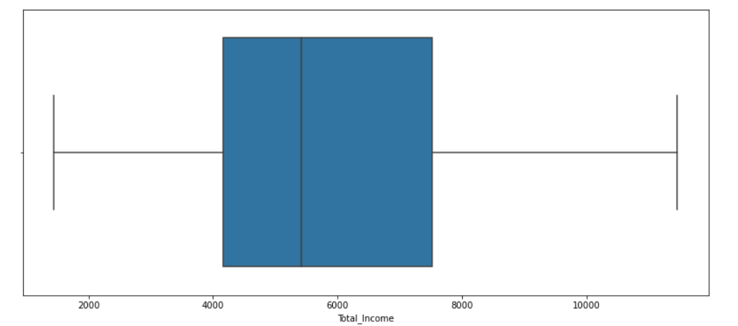
Univariate Analysis:
1) ‘Total Income’ variable is having outliers only above the max range. We can clearly see that Using box plot.
After fixing outlier’s from ‘Total Income’ Variable with quartile method.

Slide 10
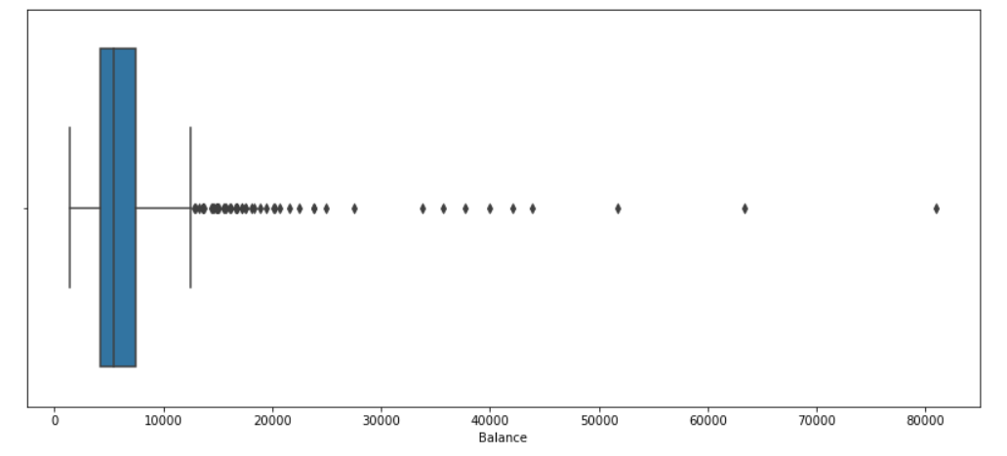
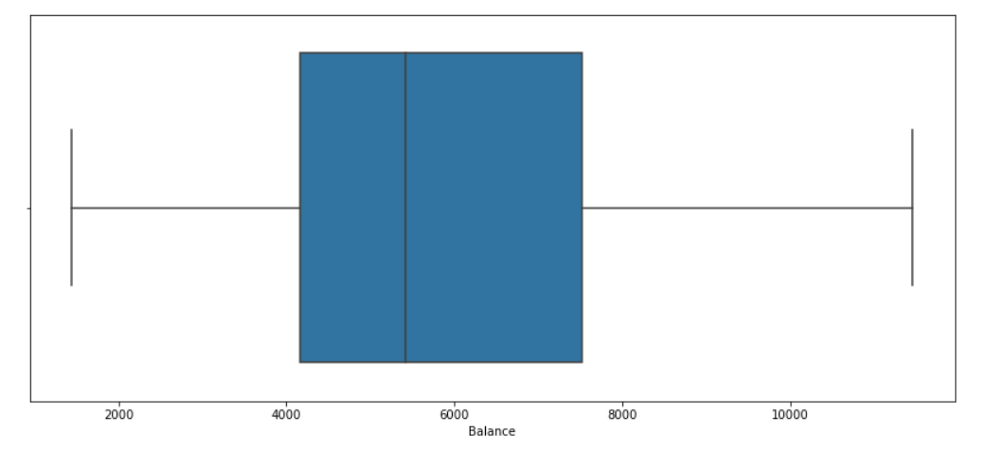
2) In our dataset ‘balance Variable’ is having outliers above the max range. Need to fix them .
After fixing outlier’s from ‘Balance’ Variable with quartile method.

Slide 11
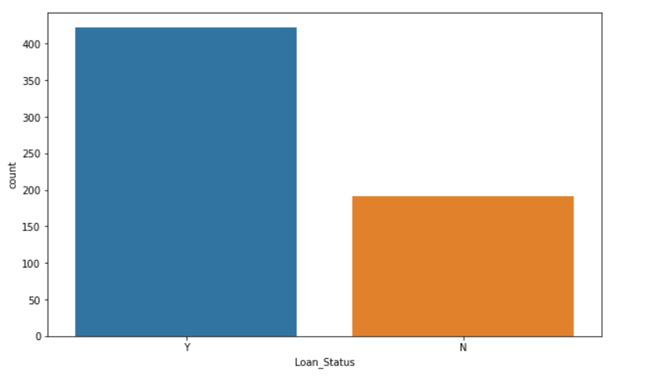
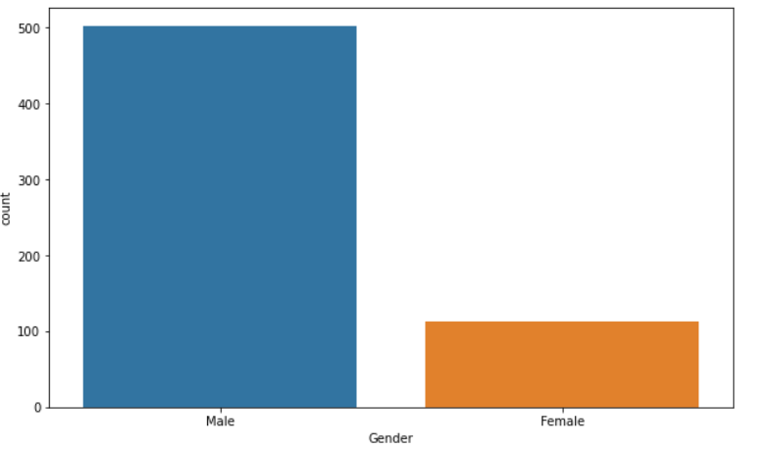
3) In our Data People who are getting Loan are 68.72% and people who are not getting loan are 31.28%.
4) In a whole population males are 81.75% and females are 18.25%. But here we cannot say, we are giving the loan on the basis of Gender because it is the clear case of discrimination.

Slide 12
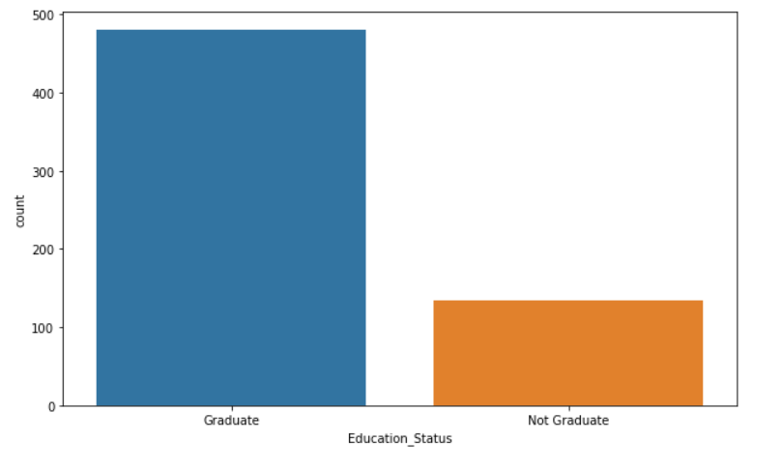
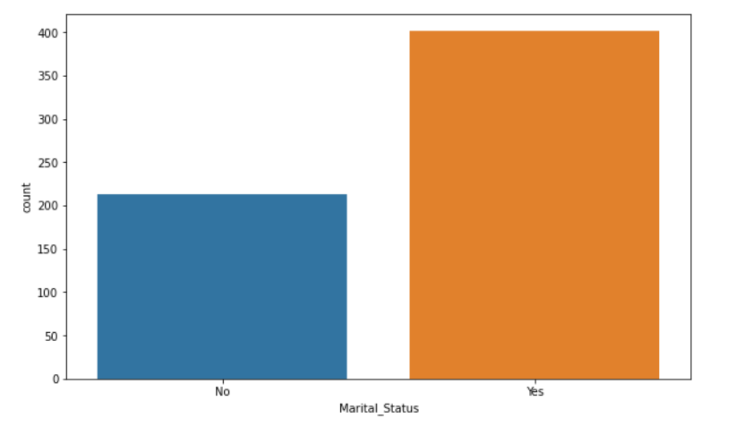
5) In our data people graduated people are 78.17% and not graduated are 21.81% with respect to Loan Status .
6) Married people are 64.82% & unmarried peoples are 35.18% in our dataset with respect to Loan Status.

Slide 13
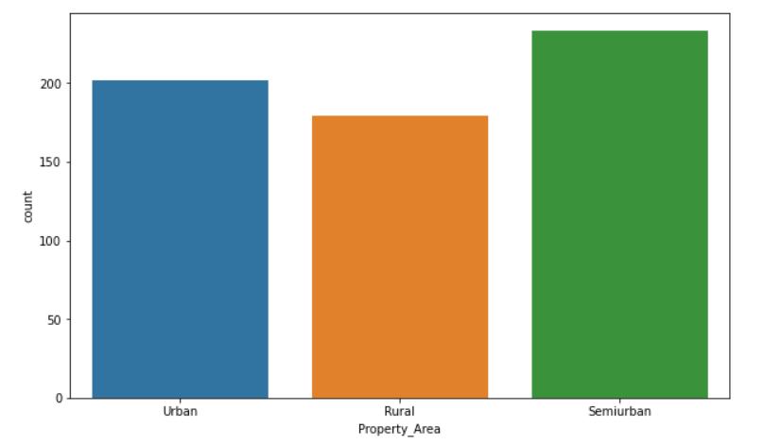
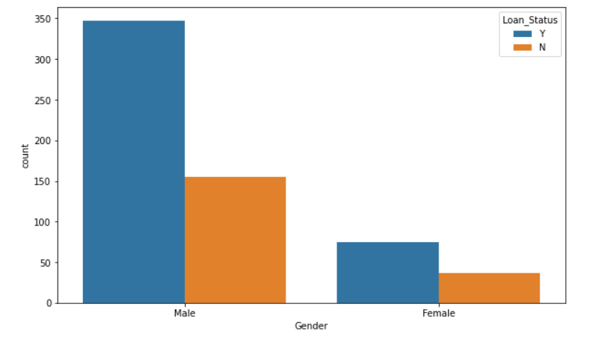
7) In our data people belonging to Semiurban area are 38.00%,people from Urban are 32.95% and people from Rural Area are 29.20%.
8) Male's who having loan status are Appx equal to 55.56% & Male's who having 'No' loan Status are Appx Equal to 24.46%...
Female's who having loan status are Appx equal to 09.78% & Female's who having 'No' loan Status are Appx Equal to 04.07%.

Slide 14
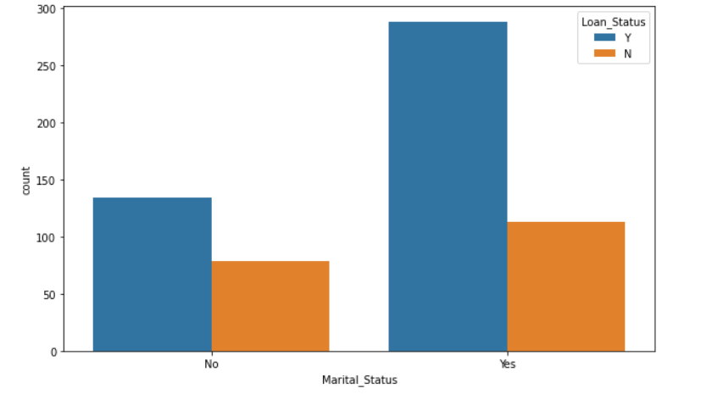
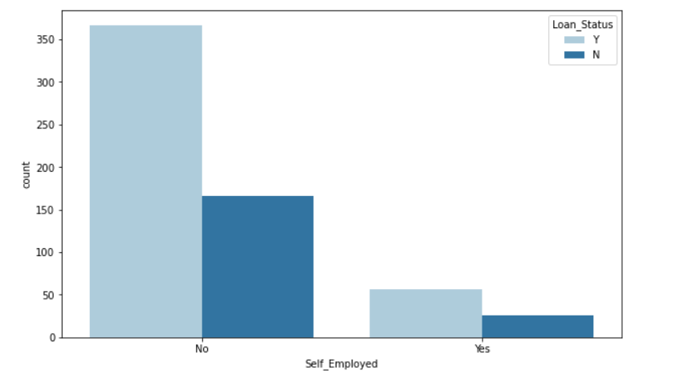
9) Unmarried people with 'yes' loan status are 22.80% and Unmarried people with 'No' Loan Status are 13.02%...
Married with 'yes' loan status are 45.60% And Married people with 'No' loan Status are 19.54%.
10) Employed people with 'yes' loan status are 57.81% and Employed people with 'No' Loan Status are 25.24%...
Unemployed with 'yes' loan status are 08.14% And Unemployed people with 'No' loan Status are 03.25%.
From this analysis we can say that people who are not self employed are getting more loan status as compare to self employed peoples.

Slide 15
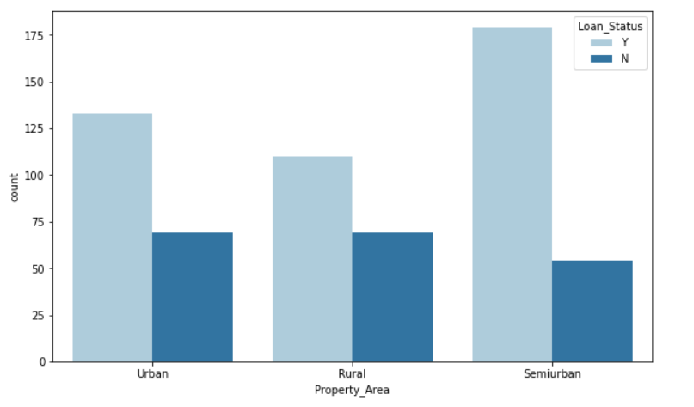
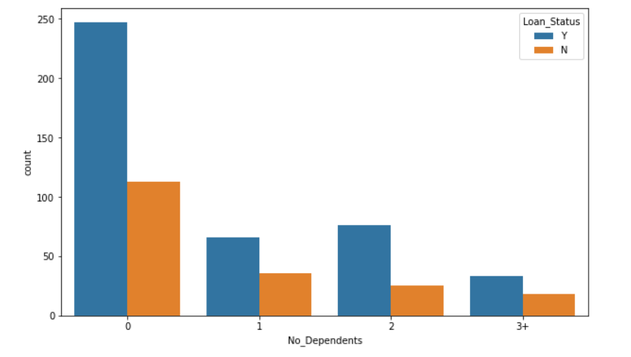
11) People having 'Yes' loan Status with 'Semiurban' Property Area are 28.50%,'Urban' Property Area are 21.17%,'Rular' Property Area are 18.72% .
People having 'No' loan Status with 'Urban' Property Area are 11.07%,'Rular' Property Area are 10.26%,'Semiurban' Property Area are 08.14%
12) People having 'Yes' loan Status with '0' Dependents are 23.61%,'1' dependents are 10.58%,'2’ Dependent's are 12.21% and '3' Dependents are 04.88%.
People having 'No' loan Status with '0' Dependents are 17.91%,'1' dependents are 05.04%,'2’ Dependent's are 04.07% and '3' Dependents are 03.25%.
From this analysis we can say that people with 0 independents are getting more yes loan status as compare to others.

Slide 16
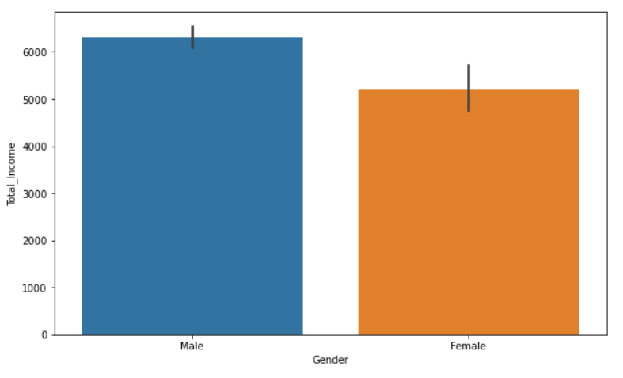
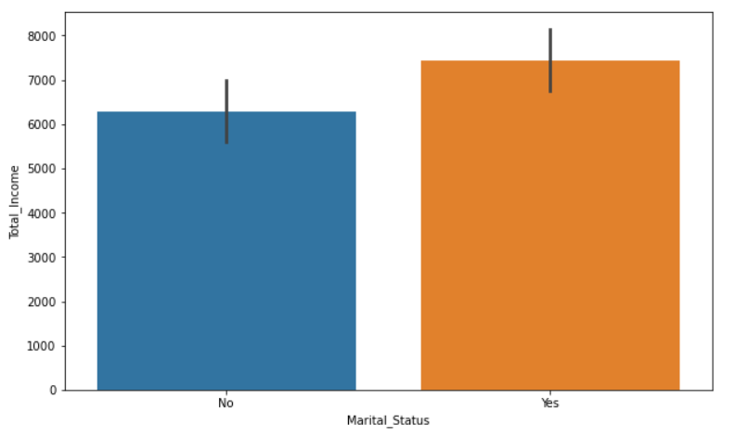
13) Average Total Income of the males is appx equal to 6000 and females is appx equal to 5000. Standard deviation of females Income are more that males Income.
14) Average Total Income of Married People is appx equal 7000 and females is appx equal to 6200. Standard deviation of males Income and females Income seems like approximate equal.

Slide 17
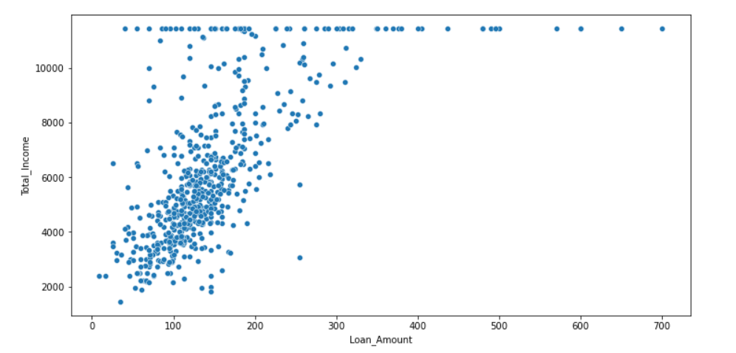
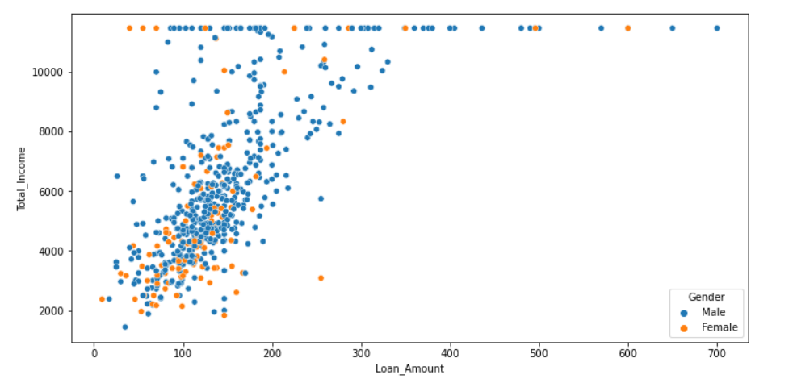
Bivariate Analysis:
1) using scatter plot we can see that as ‘Total Income’ increases ‘Loan Amount’ also increases.
2) using scatter plot we can see that as ‘Total Income’ increases ‘Loan Amount’ also increases with respect to Gender of applicant.

Slide 18
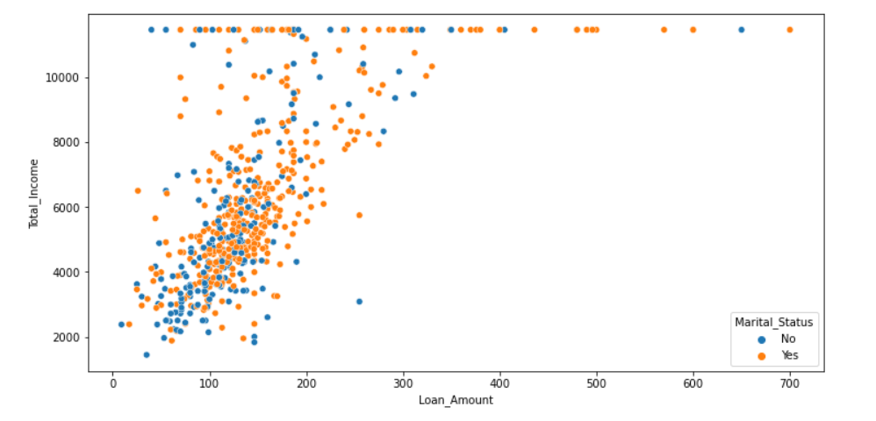
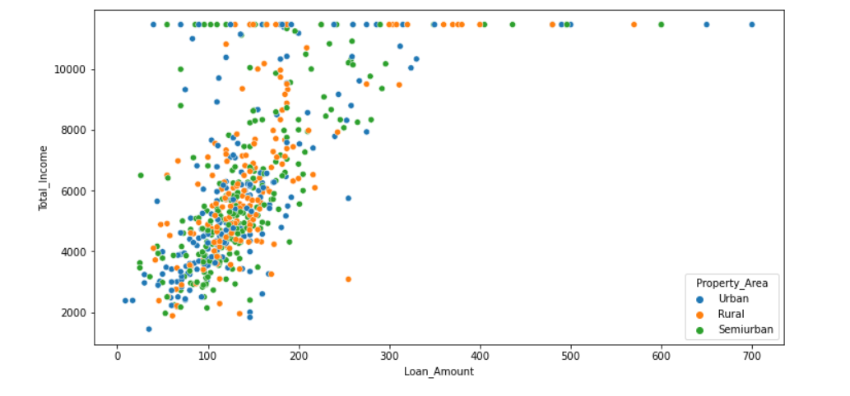
3) ‘Total Income’ increases ‘Loan Amount’ also increases with respect to Marital Status Using scatterplot.
4)Relation between ‘Total Income’ and ‘Loan Amount’ with respect to different-different property area’s.

Slide 19
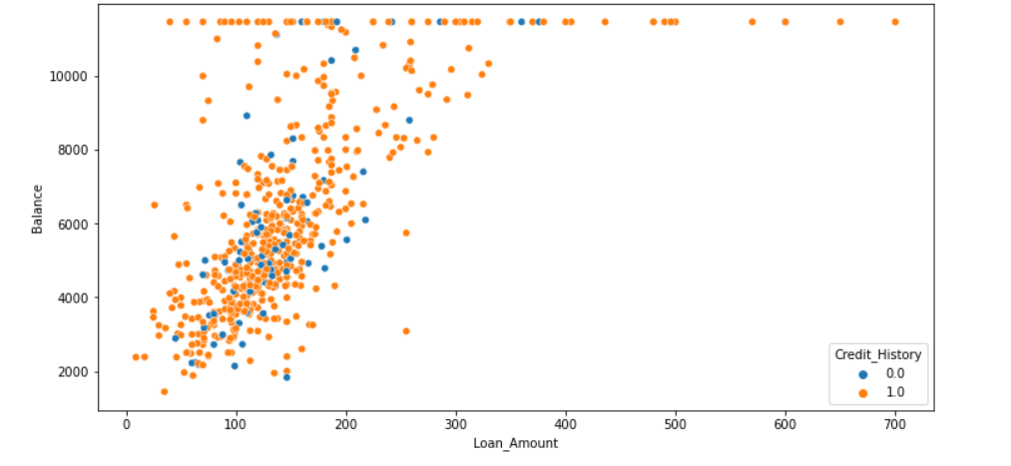
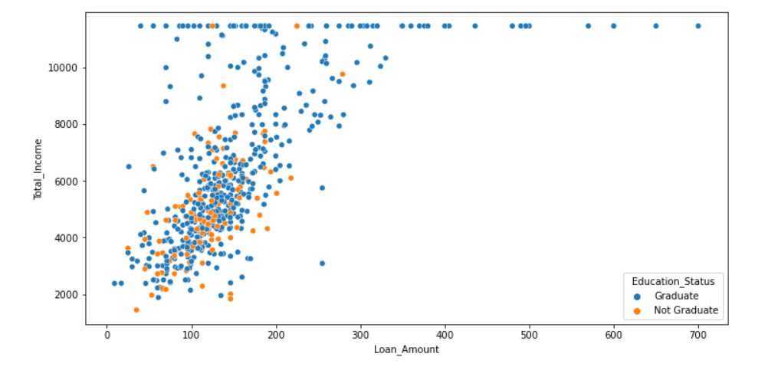
5) Relation between ‘Balance’ and ‘Loan Amount’ is having positive co-relation means ‘balance’ increases ‘Loan Amount’ also increases with respect to credit history.
6) Relation between ‘Balance’ and ‘Loan Amount’ is having positive co-relation means ‘balance’ increases ‘Loan Amount’ also increases with respect to ‘Education Status’.

Slide 20
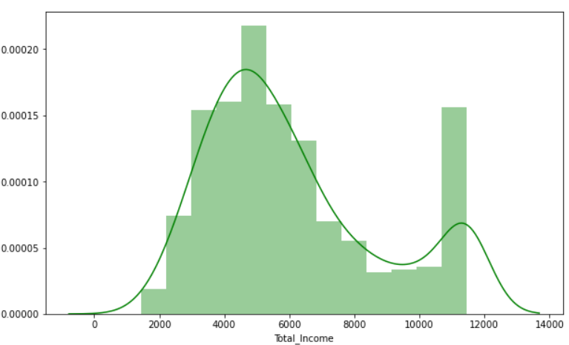
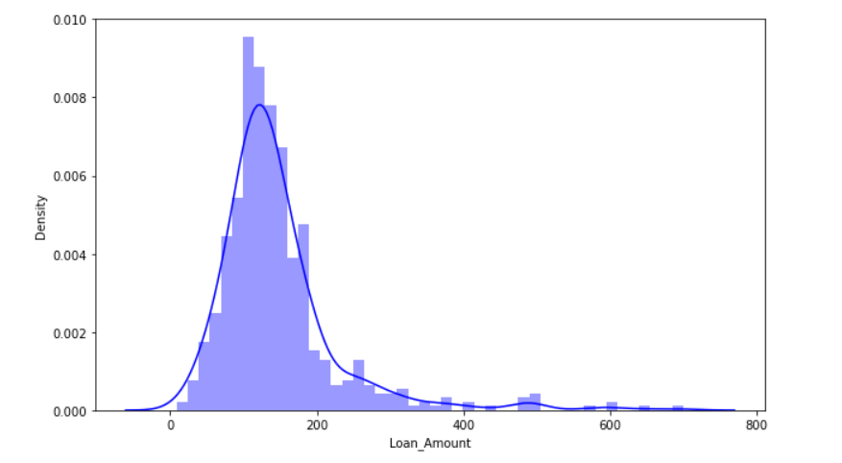
DISTRIBUTION_PLOT’S :
1) Income Variable is slightly positively skewed.
2)Loan amount Variable is positively skewed.

Slide 21
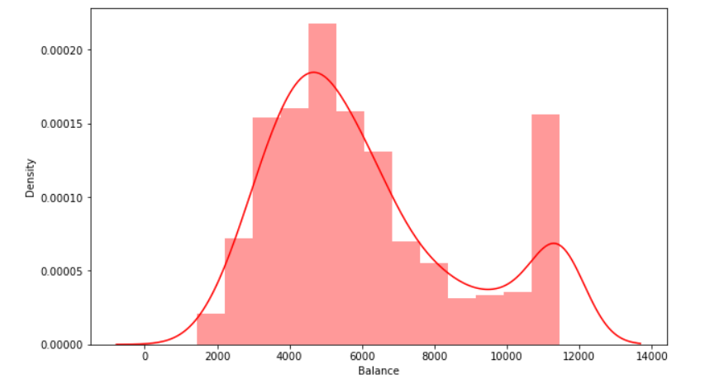
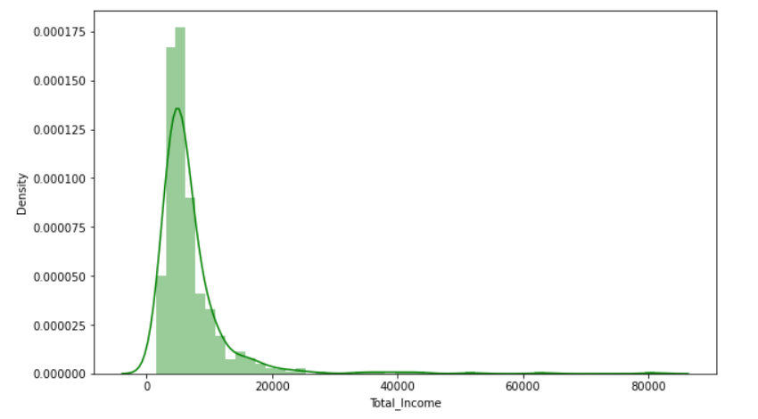
3)Balance variable is also positively skewed.
3) Total Income variable is also positively skewed.

Slide 22
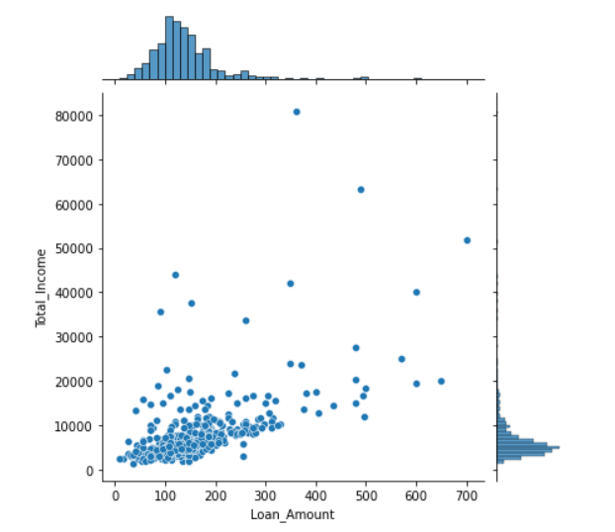
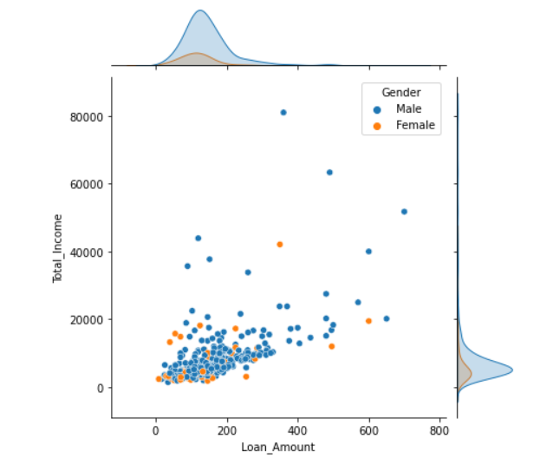
Comparison plots
1) Using joint plot we can see that ‘Total Income’ variable is positively skewed with respect to ‘Loan Amount’ variable.
2)using joint plot we can see that ‘Total Income’& ‘Loan Amount’ variable are positively skewed with respect to ‘Gender’ variable.

Slide 23
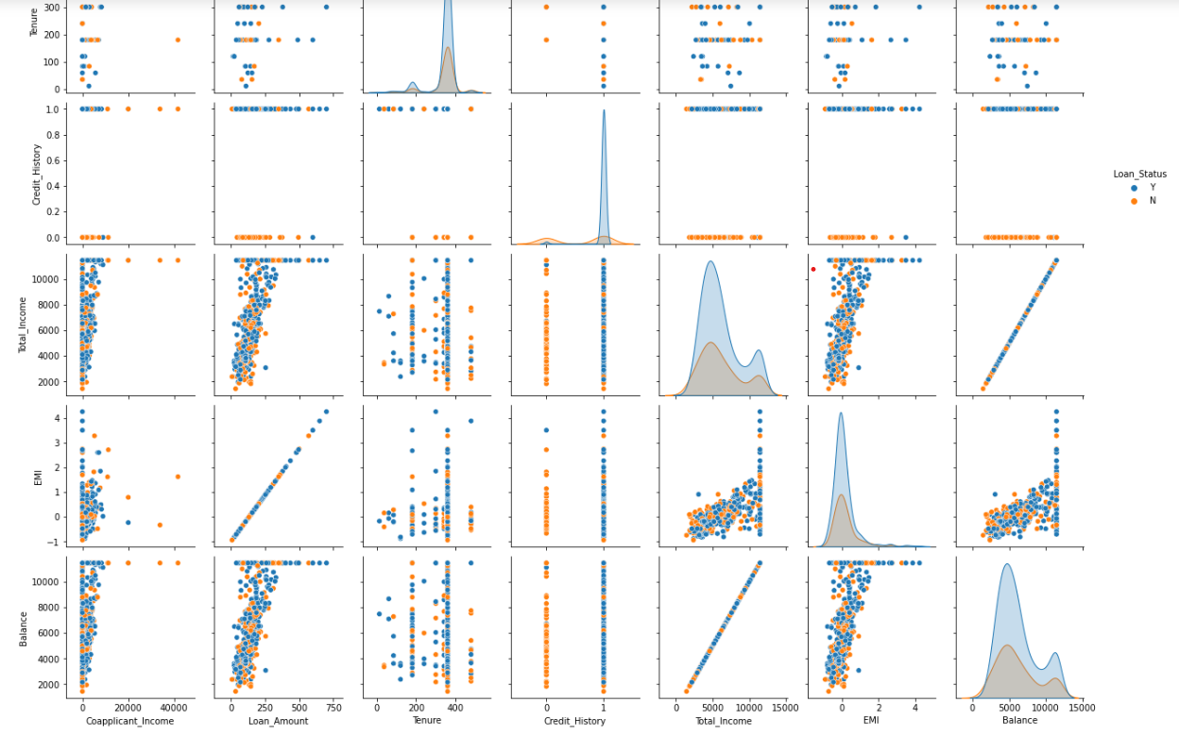
Multivariate Analysis :
Using pair plot we can plot the multiple variable .
This plot shows that as Total Income increases Loan Amount also increases with respect to Loan Status.
As Balance increases EMI also increases with respect to Loan Status.

Slide 24
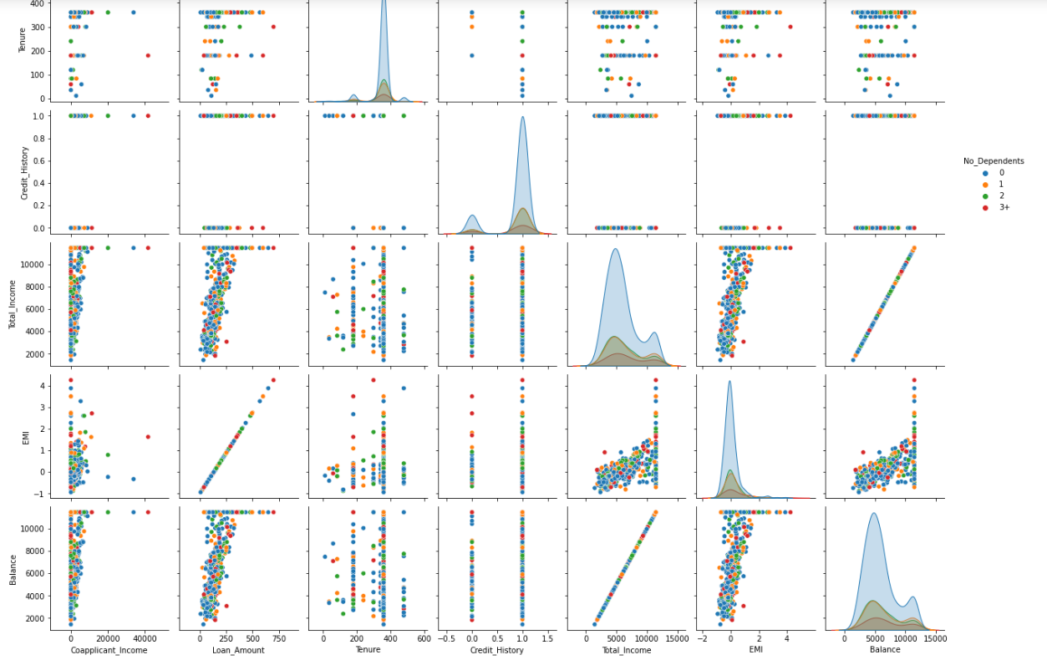
In This plot we can see that as Loan Amount increases Balance also increases with respect to number of dependent.
As EMI increases Total Income also increases with respect to number of dependent.

Slide 25
Algorithms going to be used
Machine Learning
Algorithms
Logistic Regression
Decision Tree
K-Nearest Neighbor
Random Forest
AdaBoost
Gradient Boost

Slide 26
Accuracy Metrics :-
Accuracy is the metrics which gives the information about how our model is predicting well or not in absolute sense.
Top Accuracies of all algorithms:
Accuracy of KNN Model is having better accuracy as compare to other algorithms.
Algorithms | Accuracy
Logistic Regression | 0.7837
KNN | 0.7891
Decision Tree | 0.7027
Random Forest | 0.7405
Ada Boost | 0.7459
Gradient Boost | 0.7621

Slide 27
Confusion Matrix :-
Here we have imbalance data set so we are considering the confusion matrix.
Models with the FP & FN:
KNN is having less number of incorrect records.
Algorithms | False Positive | False Negative
Logistic Regression | 38 | 2
KNN (Neighbors-5) | 37 | 2
Decision Tree | 30 | 25
Random Forest | 36 | 12
Ada Boost | 37 | 10
Gradient Boost | 36 | 8

Slide 28
Cross Validation-
Cross validation is the technique which overcomes the overfitting problem.
Types of Cross validation:
1) K-Fold Cross validation
2) Stratified Cross validation
Algorithms | K-Fold CV (Accuracy) | Stratified CV (Accuracy)
Logistic Regression | 0.8080 | 0.7996
KNN | 0.6333 | 0.6140
Decision Tree | 0.7168 | 0.7052
AdaBoost | 0.7898 | 0.7866
Gradient Boost | 0.7934 | 0.7835

Slide 29
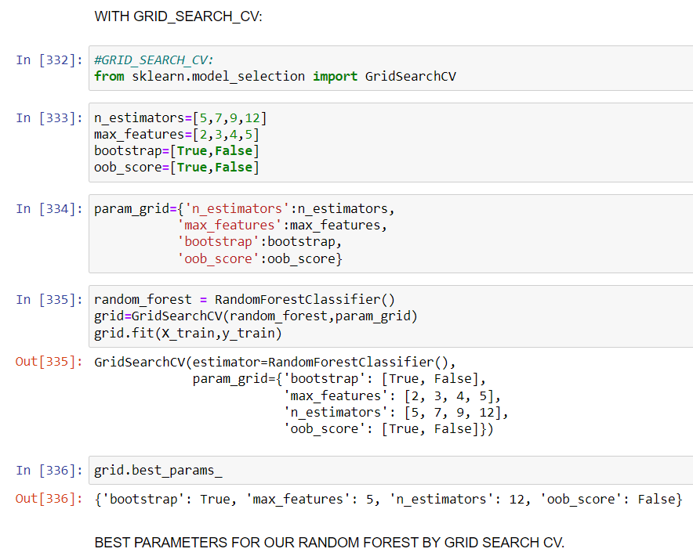
Hyperparameter Tunning
In which we take a multiple hyperparameter & created a combination of multiple hyperparameter.
Grid search gives us better hyperparameter for our Machine learning Model like here our best hyperparameter are -
‘bootstrap-True’, ‘Max_features-5’,‘n_estimators-12’, ‘oob score-True’.

Slide 30
ROC /AUC Curve :-
ROC-AUC curve is a performance measurement for classification problem at various thresholds settings. ROC is a probability curve and AUC represents degree or measure of separability. It tells how much model is capable of distinguishing.
AUC of Logistic regression is more that other algorithms.
Algorithms | AUC (%)
Logistic Regression | 74
KNN | 72
Decision Tree | 66
Random Forest | 73
Ada Boost | 70
Gradient Boost | 73

Slide 31
Model’s Performance & Comparison
Algorithms | Accuracy (%) | False Positive | False Negative | K-fold Cross_val Accuracy | Stratified Cross_val Accuracy | AUC (%)
Logistic Regression | 0.7837 | 38 | 2 | 0.8078 | 0.8061 | 74
KNN (Neighbors-5) | 0.7891 | 37 | 2 | 0.7687 | 0.7768 | 74
Decision Tree | 0.7027 | 30 | 25 | 0.7182 | 0.7444 | 66
Random Forest | 0.7405 | 36 | 12 | 0.7605 | 0.7444 | 73
Ada Boost | 0.7459 | 37 | 10 | 0.7898 | 0.7866 | 70
Gradient Boost | 0.7621 | 36 | 8 | 0.7934 | 0.7835 | 73

Slide 32
Conclusion and Future Scope
Conclusion :
The above research employs a KNN Classifier algorithm-based prediction model. To create a Knn classifier that predicts loan status, over 614 sample data were collected and evaluated. The algorithm can obtain a maximum accuracy of about 78.91 percent. The model can anticipate outcomes and is quickly adaptable to a wide range of inputs. Also, this strategy saves the banking industry and its staff a significant amount of time.
Future Scope :
Here we have small amount of data which only having 614 rows and 8 columns, so if we give sufficient amount of data then our model will be give us better results.

Slide 33
References
https://www.kaggle.com/ninzaami/loan-predication
https://www.python.org/
https://www.geeksforgeeks.org/

